Slide 1
Chicago Crime Analysis
Nathanial Hermann | Kaija Gregory | Hazel Mena

Slide 2
Violence Reduction- Victims of Homicides and Non-Fatal Shootings
This dataset contains individual-level homicide and non-fatal shooting victimizations, including homicide data from 2001 to the present, and non-fatal shooting data from 2010 to the present (2010 is the earliest available year for shooting data).
Dataset cleaned to only include top ten most violent neighborhoods: West Garfield Park, Washington Park, Austin, East Garfield Park, Englewood, North Lawndale, Grand Crossing, West Englewood, Riverdale, and South Shore.
Information provided by the Chicago Police Department

Slide 3
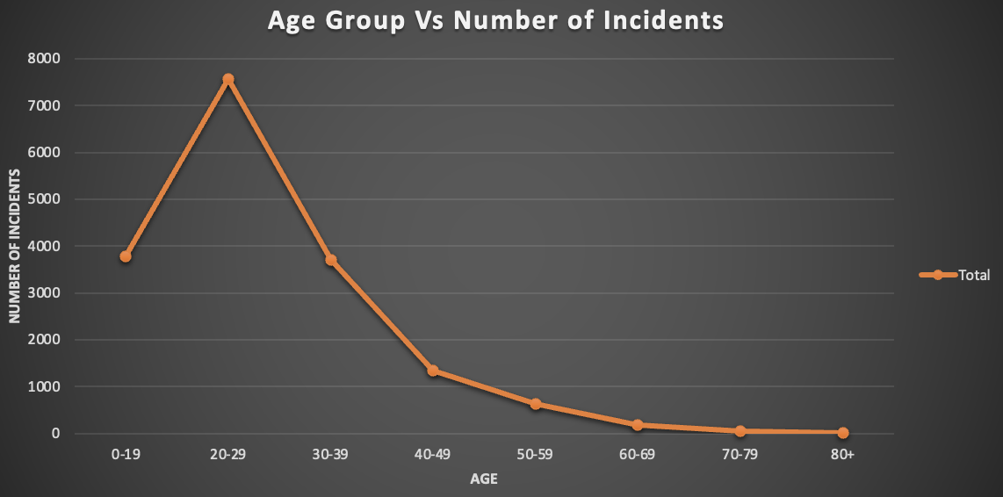
THE RELATIONSHIP BETWEEN CRIME AND AGE GROUP
Notes:
INCIDENTS REFERS TO HOMICIDE, ROBBERY, AND BATTERY. BASED ON THIS GRAPH WE CAN SEE THAT THE AGE GROUP 20-29 ACCOUNT FOR THE MOST NUMBER OF CRIMES.

Slide 4
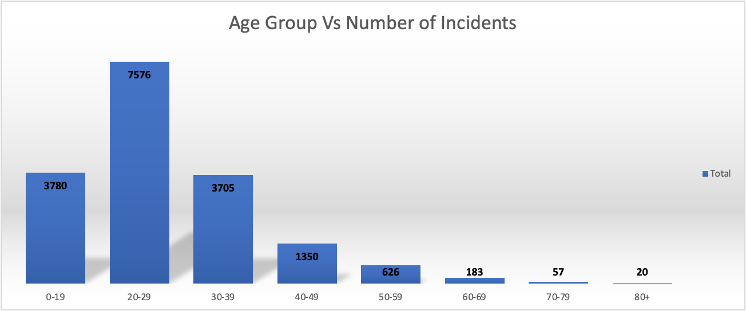
THE RELATIONSHIP BETWEEN CRIME AND AGE GROUP

Slide 5
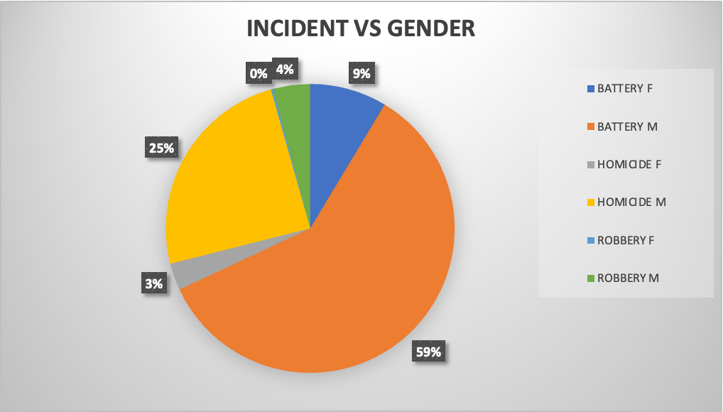
THE RELATIONSHIP BETWEEN CRIME AND GENDER
Notes:
BASED ON WHAT WE SEE IN THIS CHART, BATTERY COMMITTED BY MALES ACCOUNTS FOR MORE THAN HALF OF THE CRIME IN OUR DATASET. ROBBERY COMMITTED BY FEMALES ACCOUNTS FOR LESS THAN ONE PERCENT

Slide 6
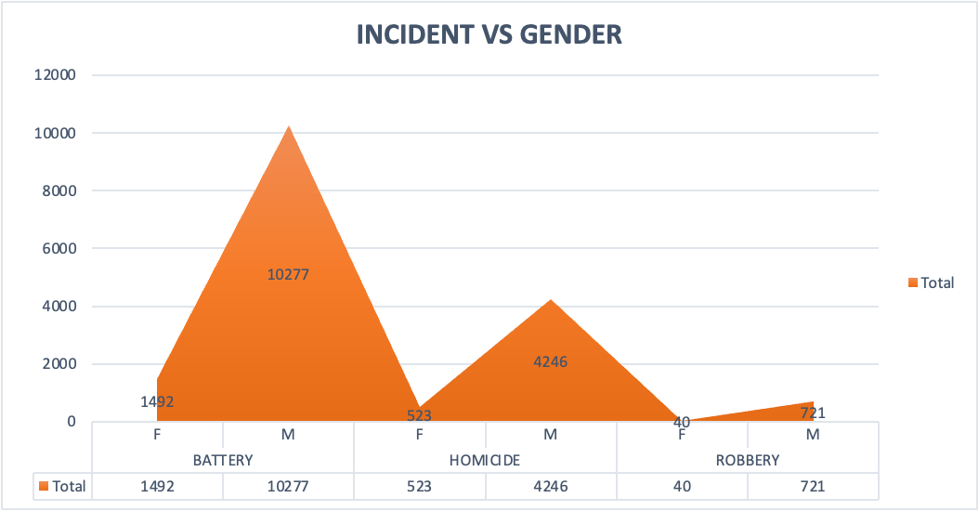
THE RELATIONSHIP BETWEEN CRIME AND GENDER

Slide 7
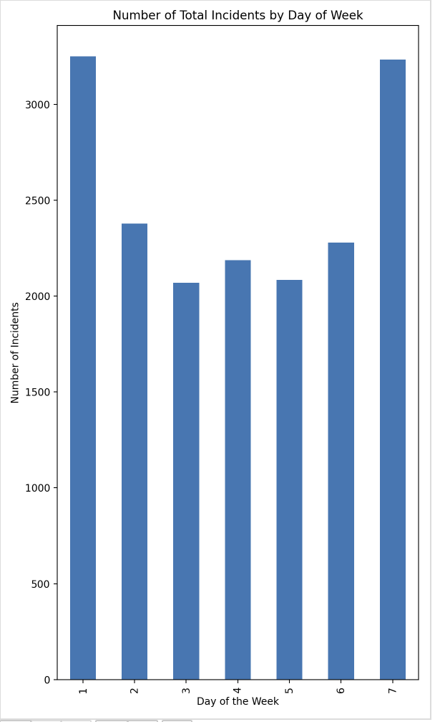

Slide 8
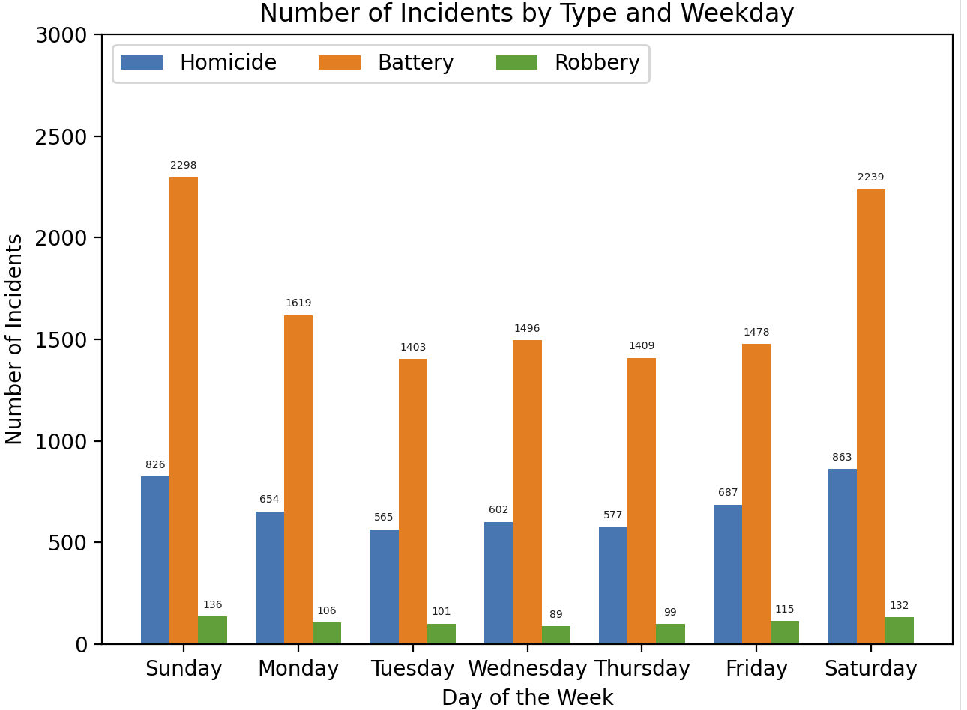

Slide 9
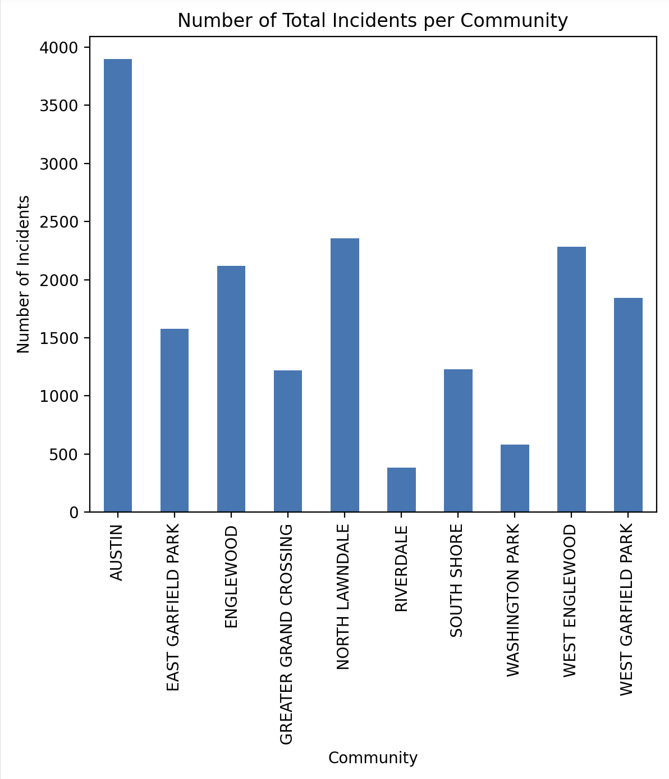

Slide 10
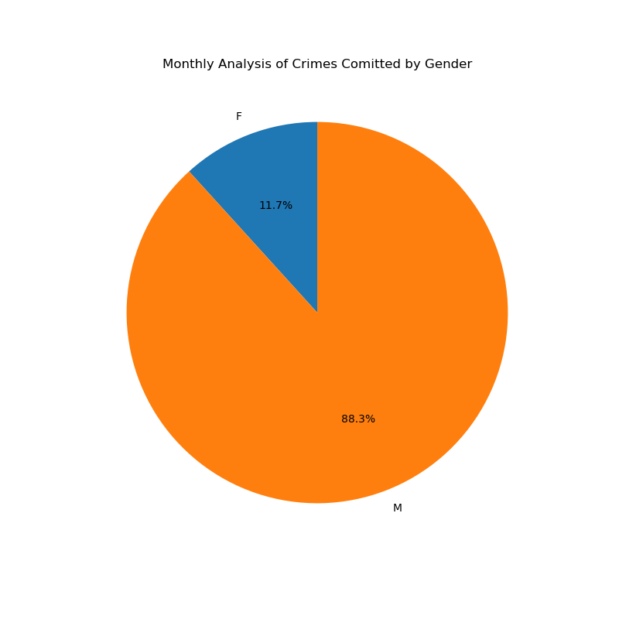

Slide 11
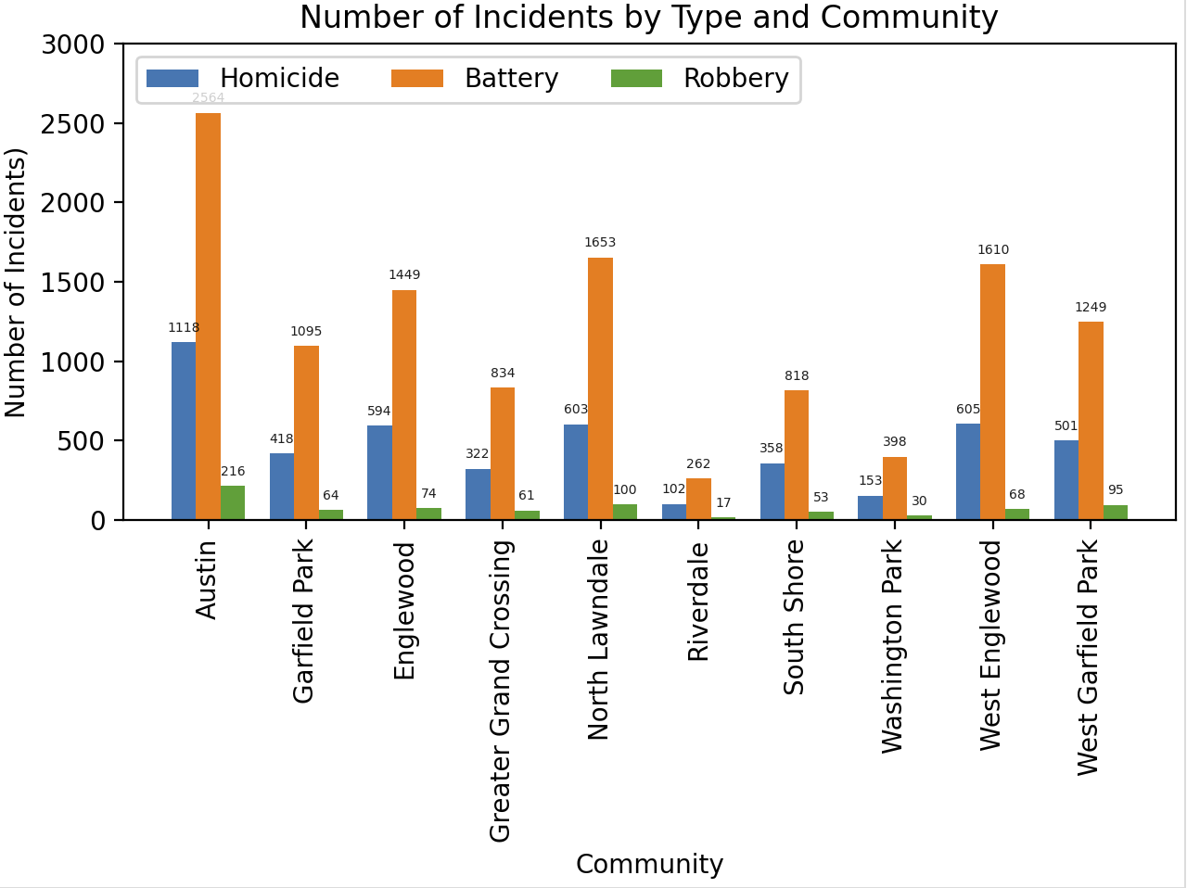

Slide 12
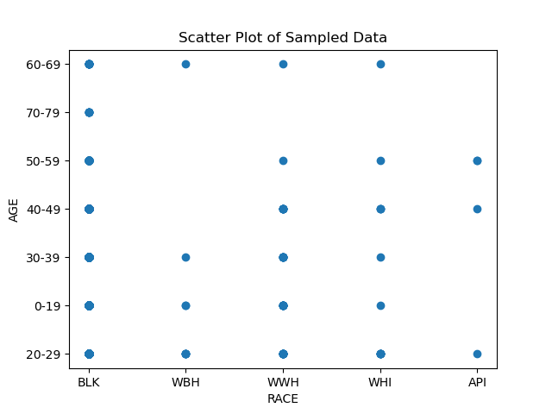

Slide 13
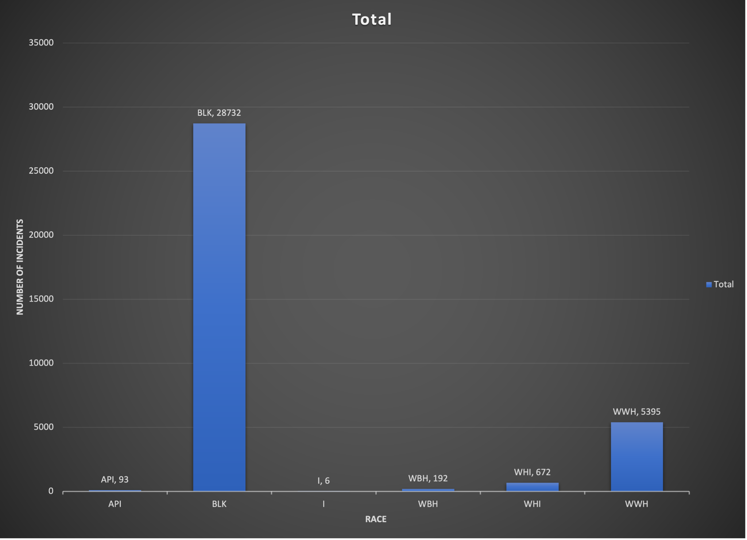

Slide 14
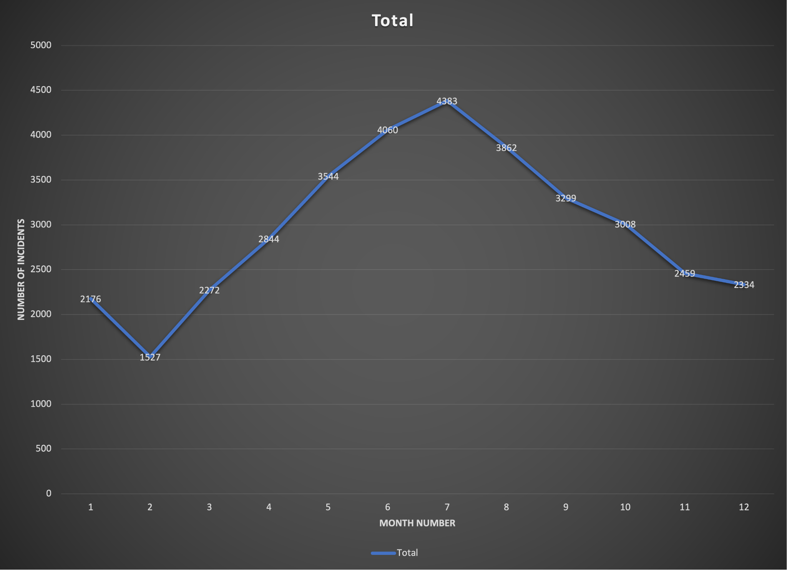

Slide 15

ANY QUESTIONS?

Slide 16

THANK YOU!

